Slide 1
EVENT MANAGEMENT AND WASTE FOOD MANAGEMENT SYSTEM
Project By:
VINAY KANGOKAR
SHUBHANGI CHANORE
ARCHIE SHAH

Slide 2
PROBLEM STATEMENT
People usually spend a lot of time to search and book a party hall which is time consuming. People also find difficulties in shortlisting a particular place to plan their event. It is time consuming to visit all the places and find the right place to plan an event. People also face issues while planning an event which must fit within their budget. A lot of food is usually wasted which can be used to feed the needy.

Slide 3
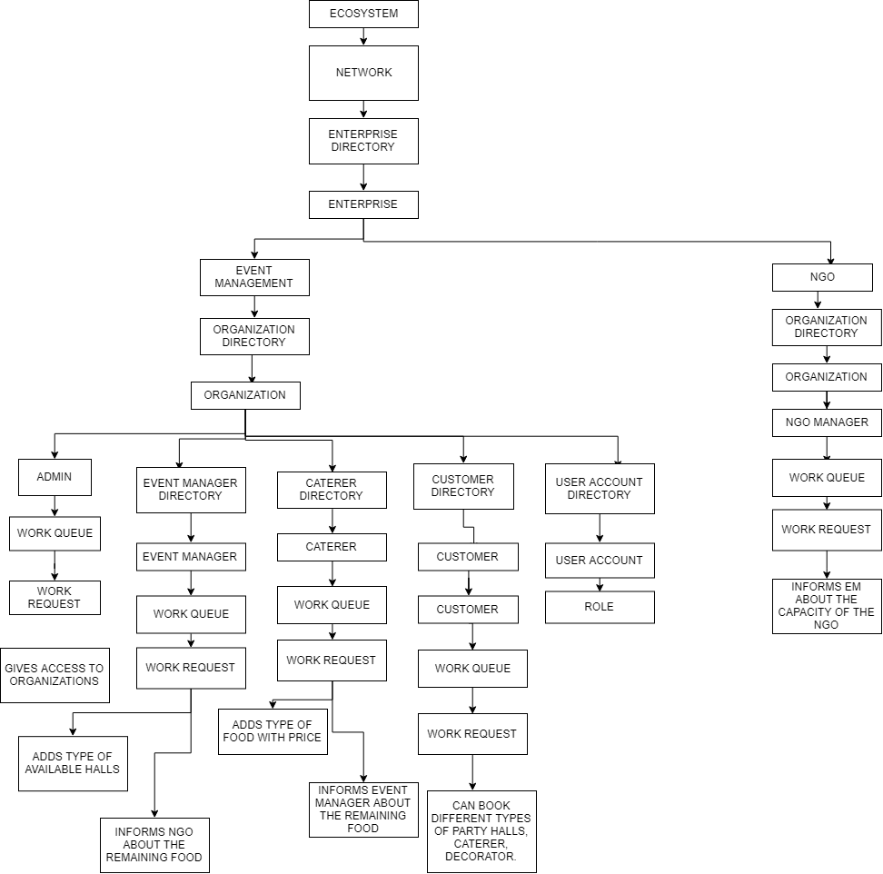
Object Model

Slide 4
ENTERPRISES
EVENT MANAGEMENT ENTERPRISE
NGO ENTERPRISE
CUSTOMER ENTERPRISE

Slide 5
Organization
Event Manager
Caterer
NGO
Customer

Slide 6
APPROACH
Customer notifies his requirements to the event manager.
Event manager requests the particular caterer based on customer's requirements.
The caterer accepts the request from the event manager.
Event manager then books the hall type and caterer specified by the customer.
The remaining food is being notified by caterer to an event management • Event manager then sends the request to NGO and a particular NGO accepts the request.

Slide 7
USE CASES
EVENT MANAGEMENT COMPANIES will add different Event Managers and caterers
EVENT MANAGER adds different party halls with its type and price
CATERER adds type of food with price
NGO Enterprise adds different types of NGO’s

Slide 8
USE CASES
CUSTOMER adds his requirements according to the parameters like budget, date, type of party hall, type of food
The Event Manager books party hall as well as caterer for customer seeing his requirements

Slide 9
USE CASES
Caterer informs the Event Manager about the left over food in the event
The Event Manager informs the relative NGO with respect to the number of the people in that particular NGO

Slide 10
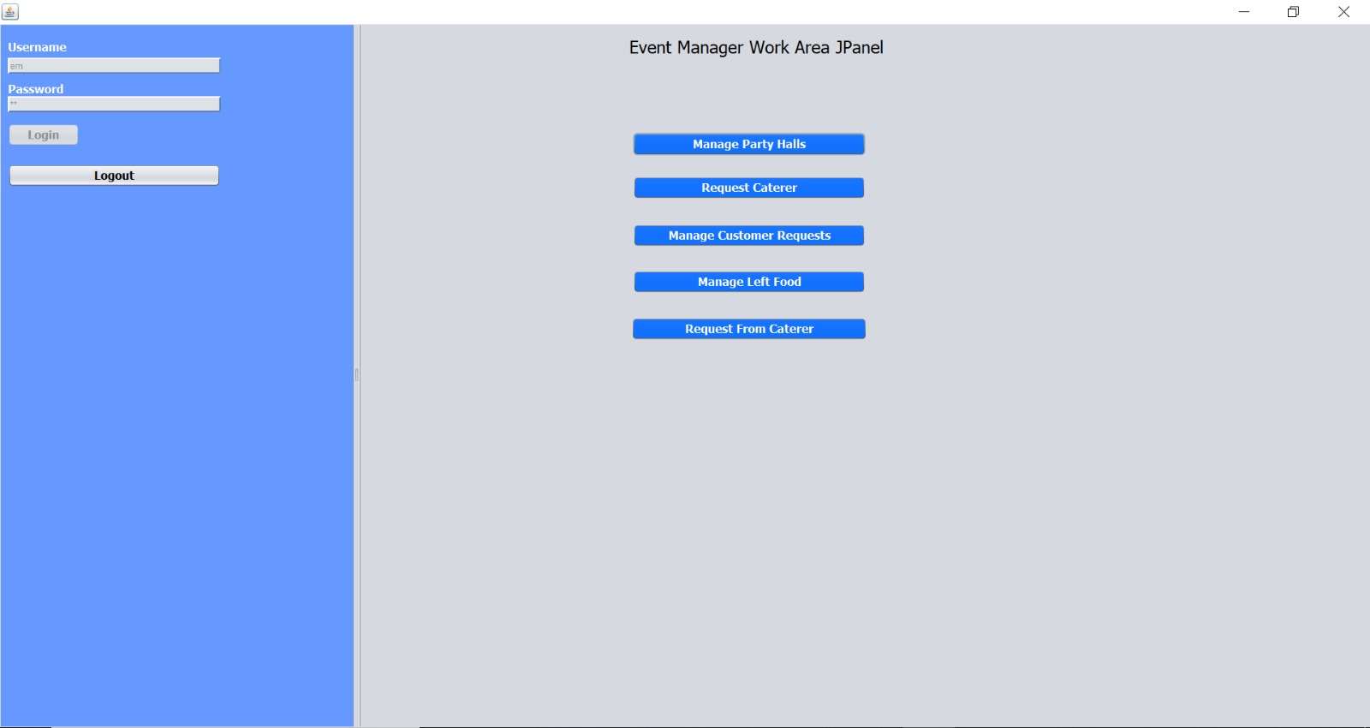
EVENT MANAGER LOGIN
Event Manager will be able to perform the below mentioned tasks:

Slide 11
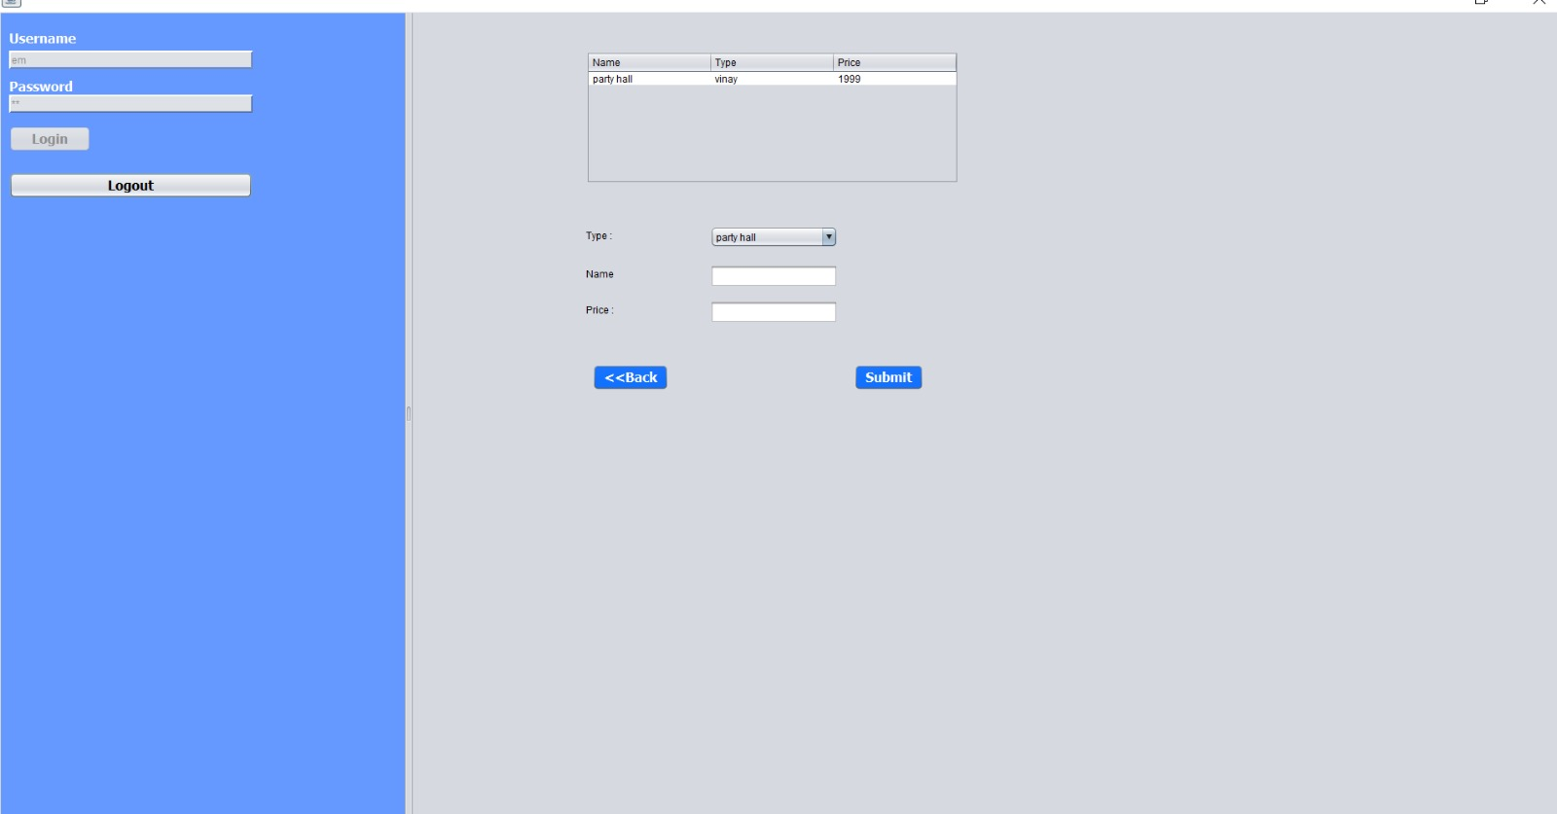
EVENT MANAGER LOGIN
Event Manager will be able to manage all the party halls, lawns, etc

Slide 12
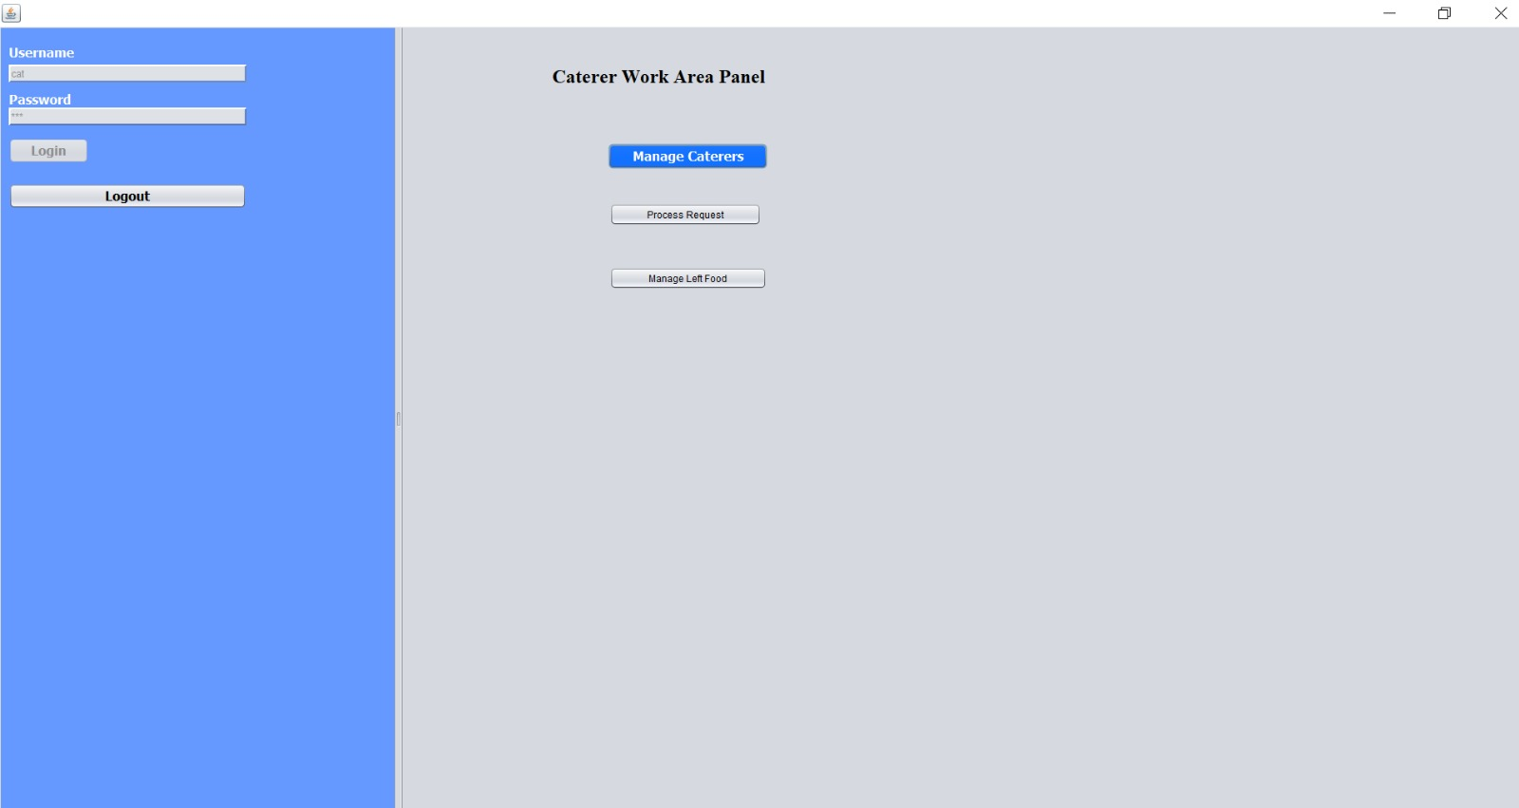
CATERER LOGIN
Caterer will be able to manage his/her food types and prices
It will be able to accept or reject the order request given by a event manager

Slide 13
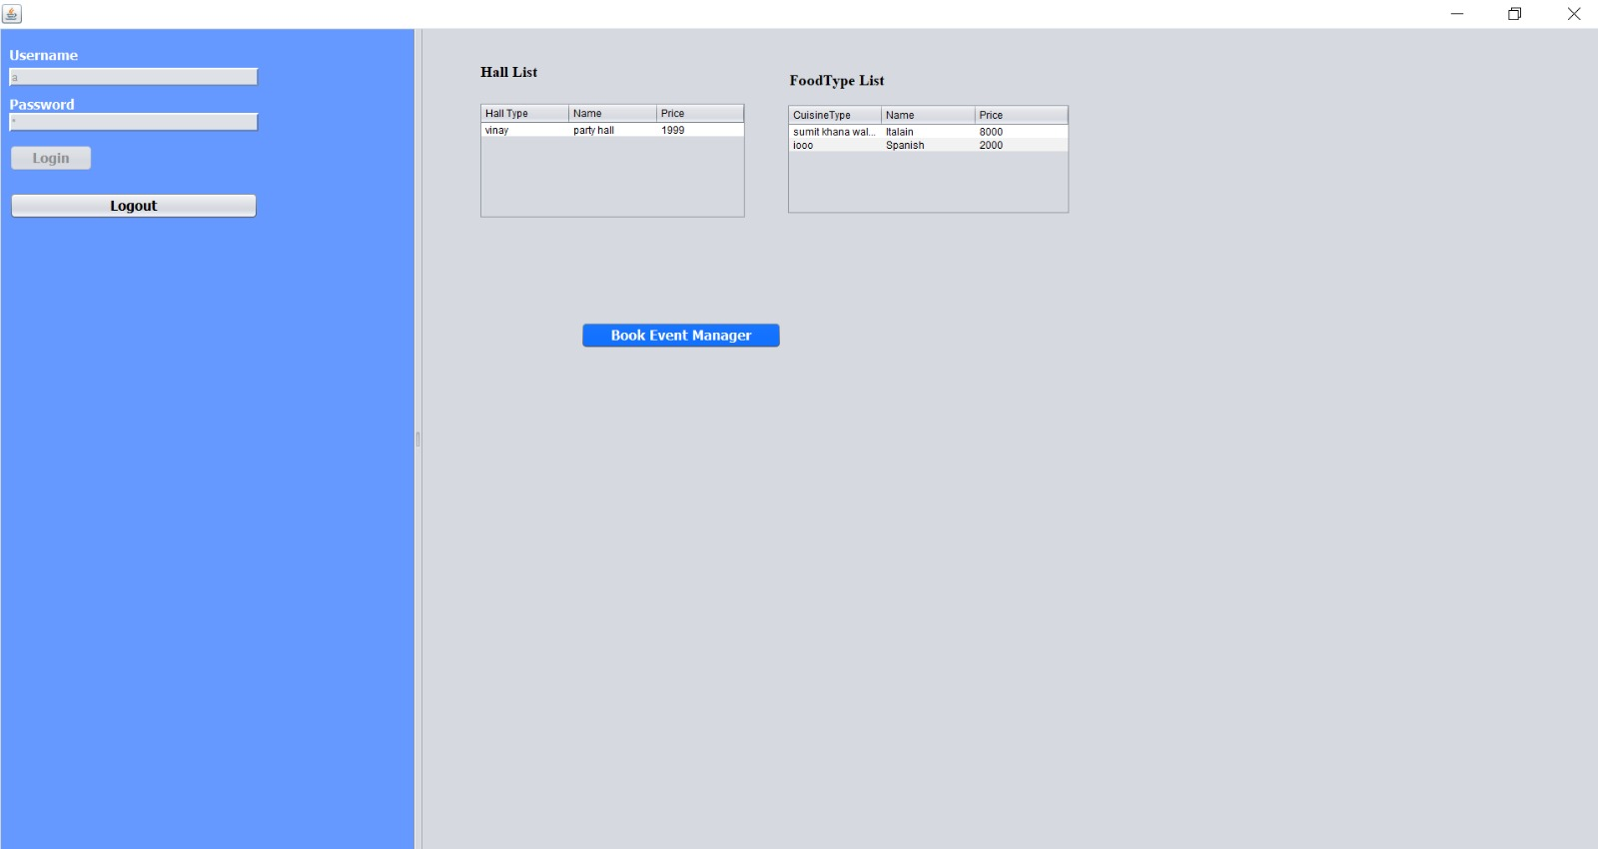
CUSTOMER
Customer will be able to see the list of halls and food type as per the price
Customer will be able to book an event manager

Slide 14

NGO
NGO will be able to receive the remaining food information from the event manager
NGO will be able to manage the different NGOs under it

Slide 15
THANK YOU!!

